Slide 1
Project 1
Serverless Image Processing
Presented by Krati Pandey

Slide 2
About the project create a serverless image processing application that automatically resizes and optimizes images uploaded to an amazon S3 bucket

Slide 3
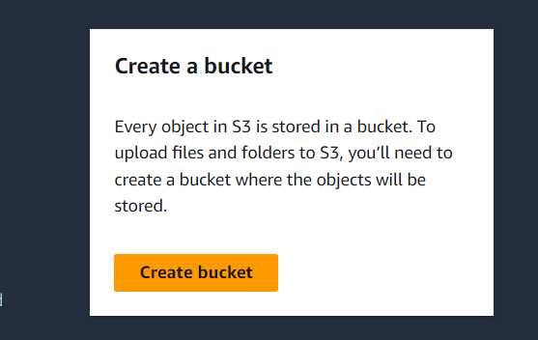
Step 1: Sign in to the AWS console
Step 2: Go to the service menu search S3 bucket.
Step 3: Then click on the create bucket.
Step 4:Create the source bucket.

Slide 4
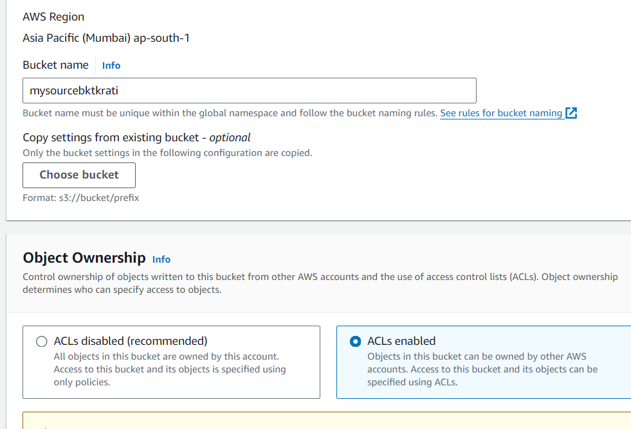
Step 5:Enter your bucket name and enable ACL. Untick the column block all public access .

Slide 5
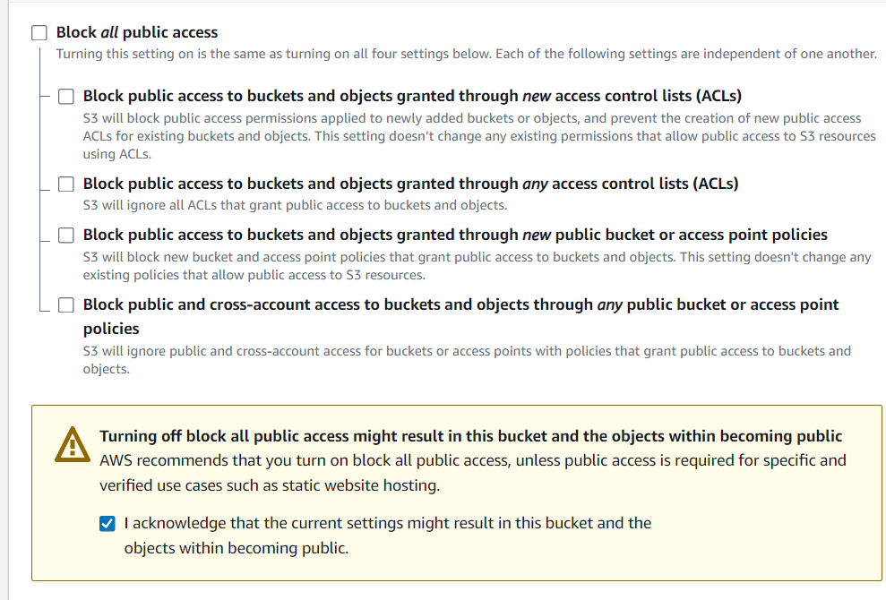
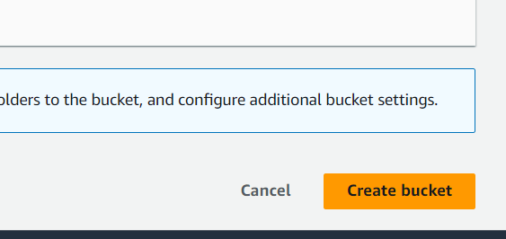
Step 6:Click on the create bucket.

Slide 6
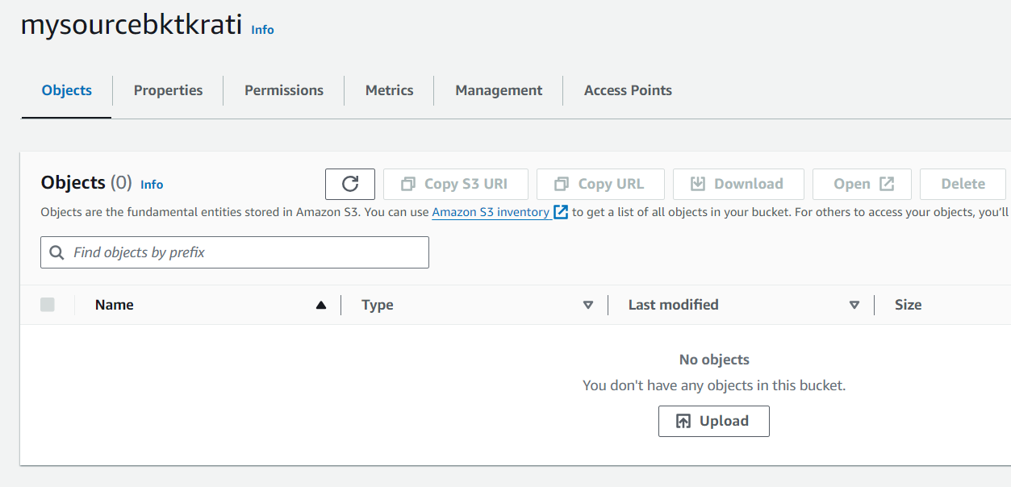
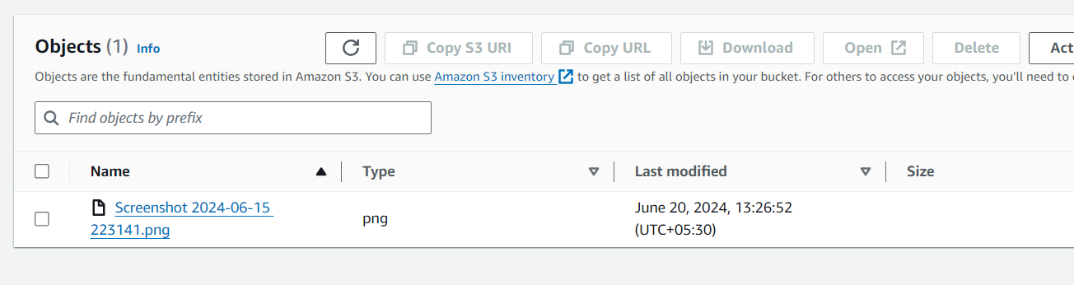
Step 7:Now upload the image on source bucket by clicking the upload.
Step 8:Your image has been uploaded. Now create a destination bucket.

Slide 7
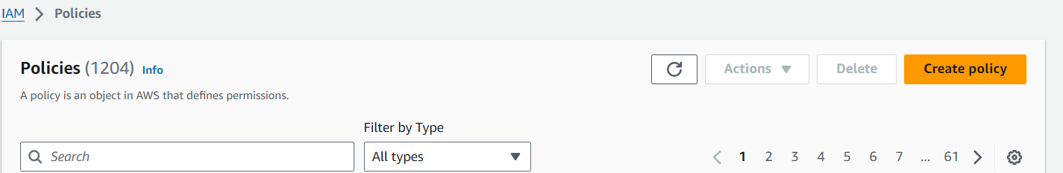
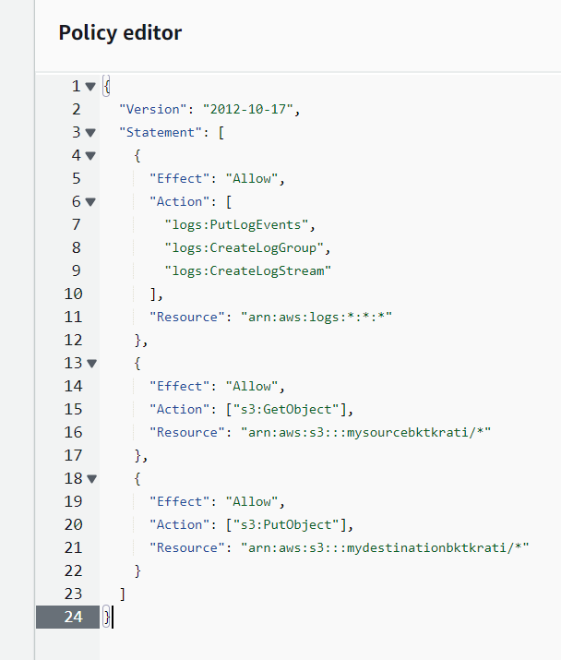
Step 9:Now go to the IAM console and click the policies and create policy.
Step 10:Click on the JSON and write the above code in policy generator.

Slide 8
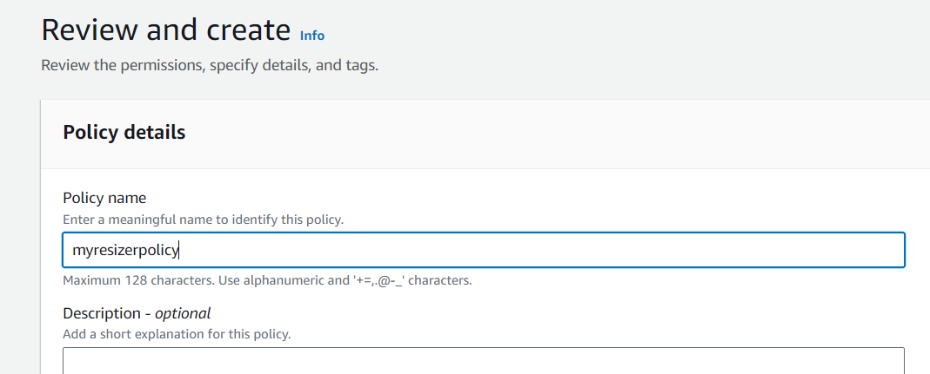
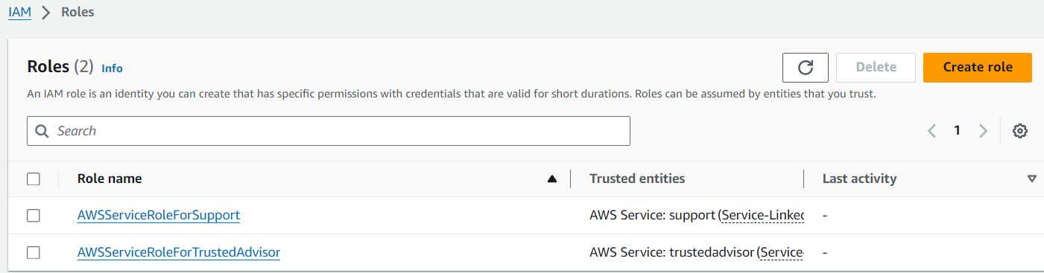
Step 11:Click on the next then enter your policy name.
Step 12: Now we have to create role so go to the role and click on the option of create role.

Slide 9
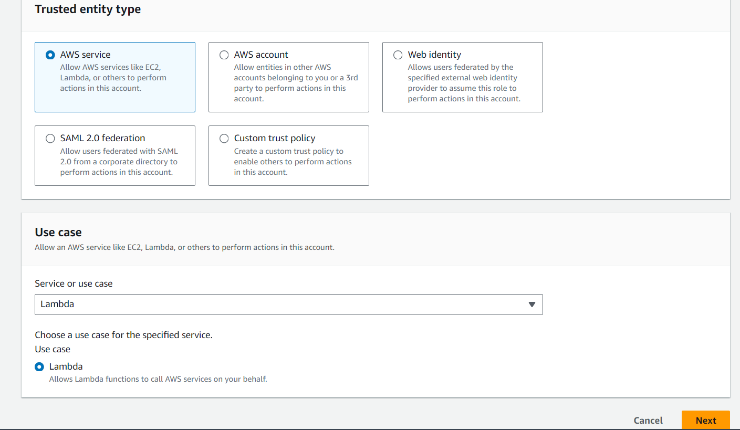
Step 13:Then select the policy that you have created before. Then click on the next option and enter your role name & click on the create role.

Slide 10
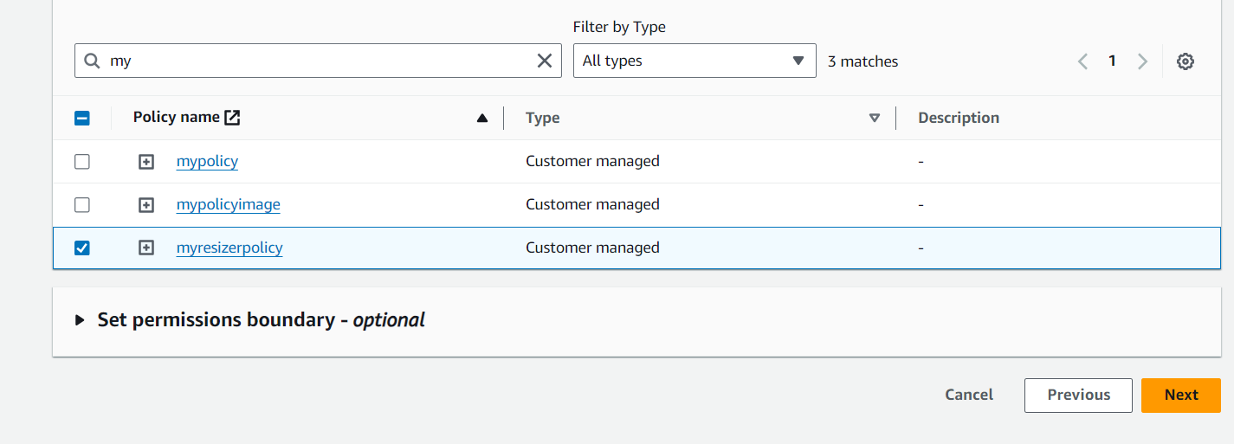
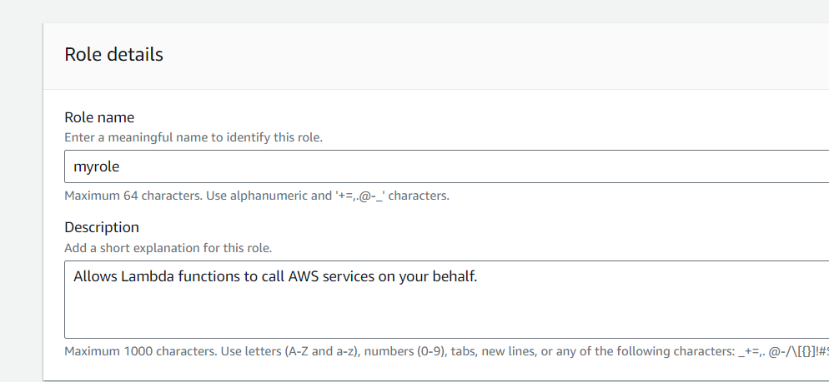

Slide 11
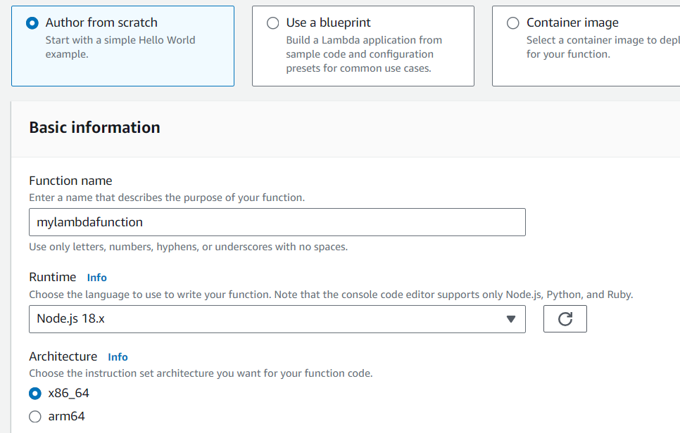
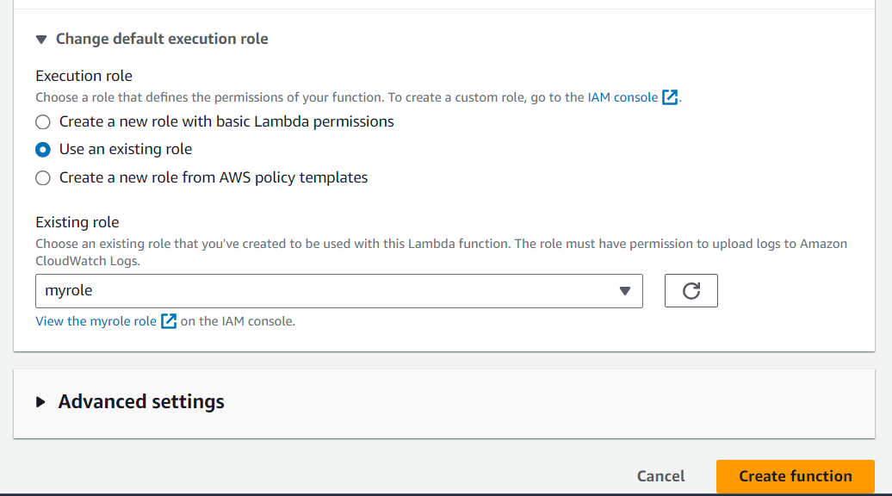
Step 14:Now go to the lambda and create lambda function then select author from scratch. Enter your function name in runtime select node.js 18.x in execution select use an existing role & select role that you have created before. And click the create role.

Slide 12
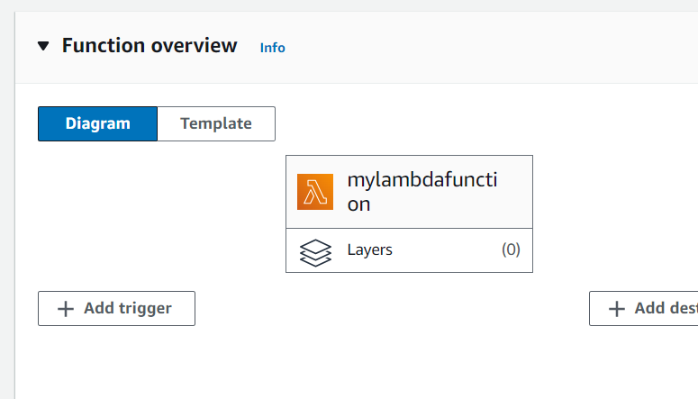
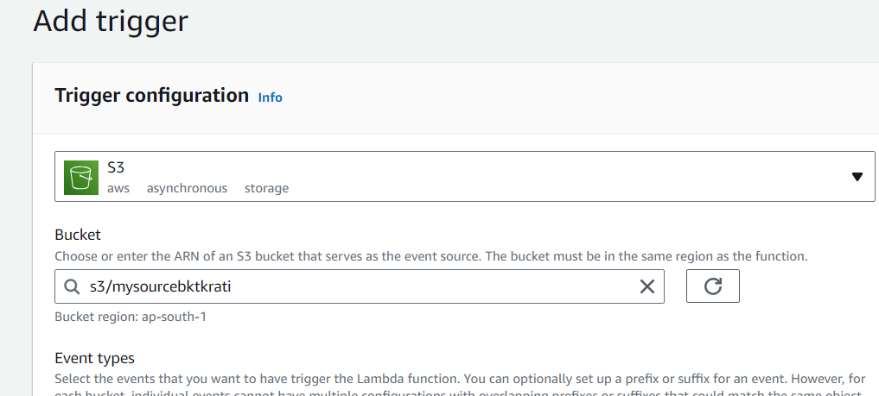
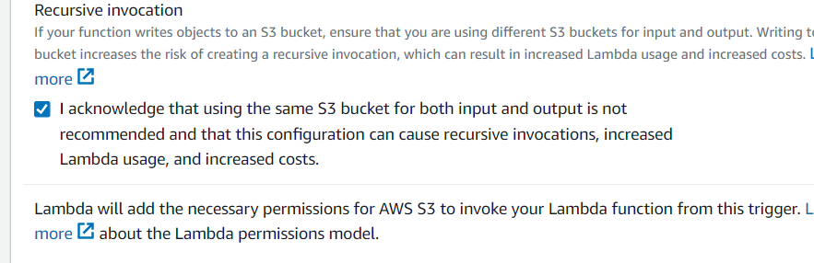
Step 15: Your lambda function has been created then click on the option of Add trigger.
Step 16:In add trigger select S3 and enter your source bucket name and click the add.

Slide 13
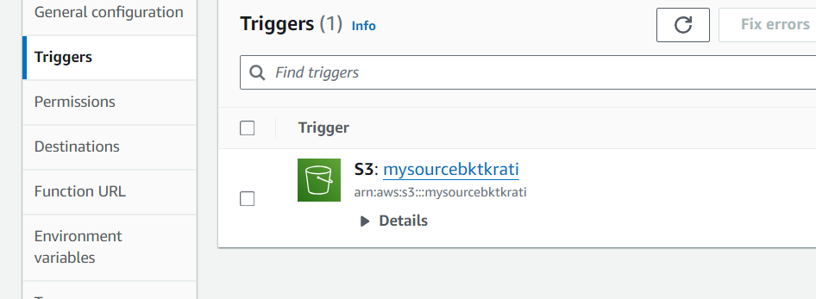
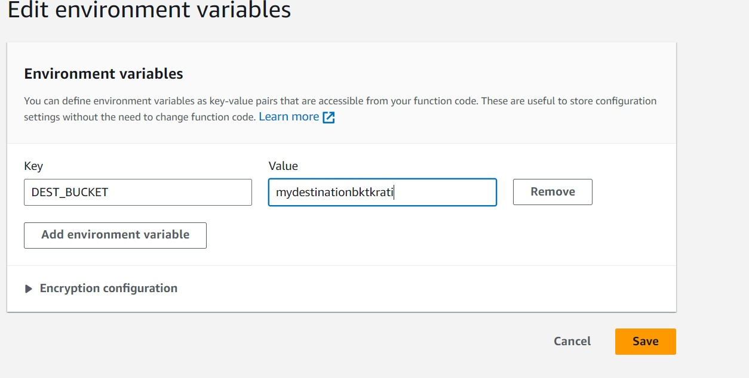
Step 17: Now go to the configuration under configuration select environment variables.
Step 18:In environment variable select add environment variable & enter the key DEST_BUCKET & enter value your destination bucket name. Click on save.

Slide 14
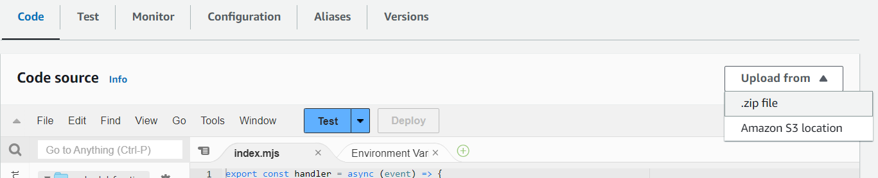
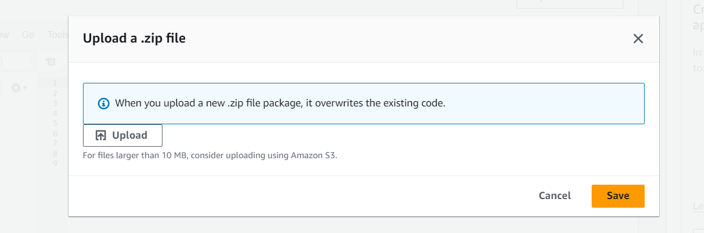
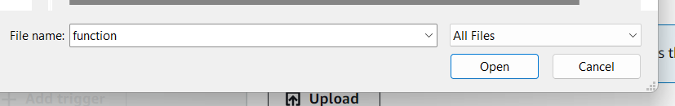
Step 19: Go to the code under code click on upload from and upload zip file.
Step 20: Click on the upload & upload the zip file .

Slide 15
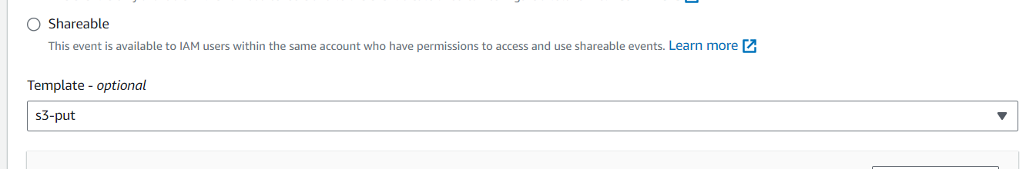
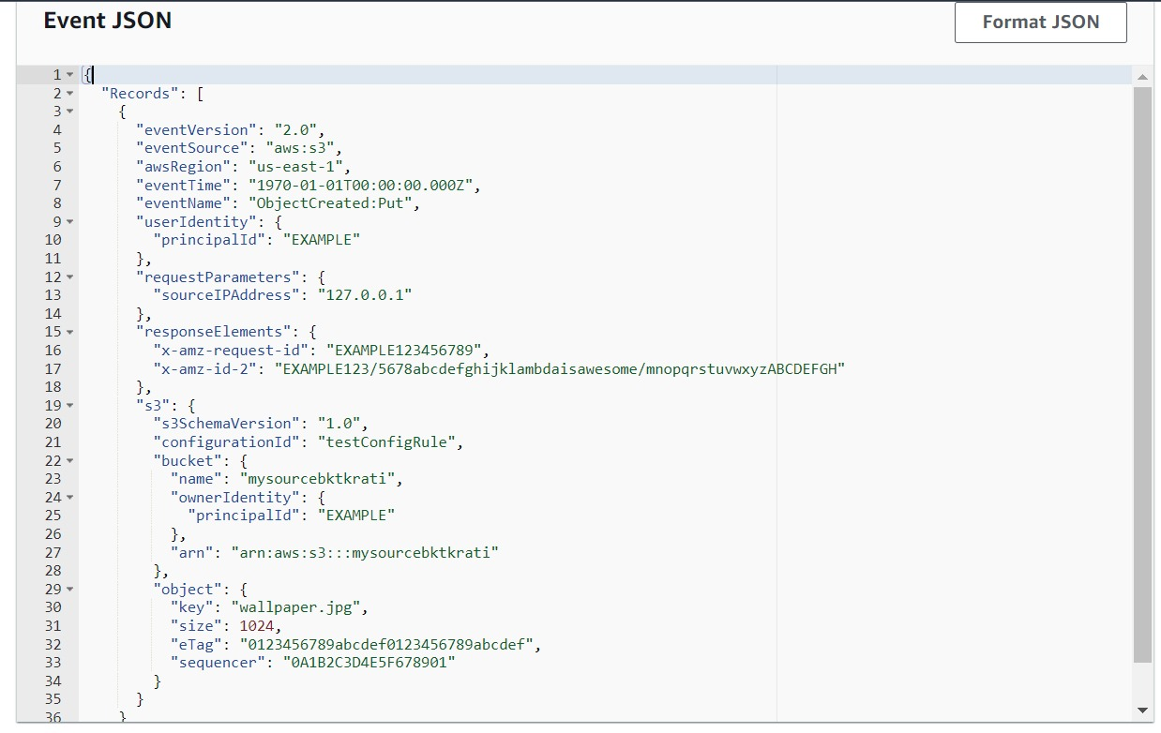
Step 21: Now go to the test under test in the temporal option select S3 Put .

Slide 16
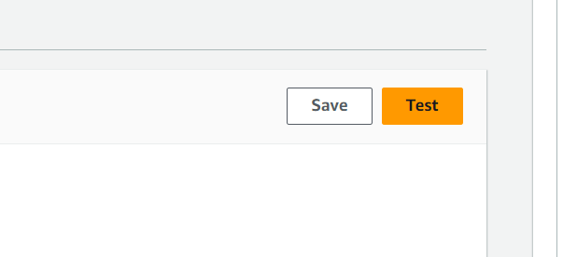
Step 22: In the above code enter your source bucket name in place of name & ARN & in the key enter your image name .Then click on the test .
Step 23: Now your execution function is succeeded .Go to the destination bucket your resize image will be shown there.

Slide 17
thank you
Submitted by: Krati pandey

